Slide 1

Understanding Geopolitical factors and Covid-19 data
Eliot Cleveland
Gina Freed
Marc Leslie

Slide 2

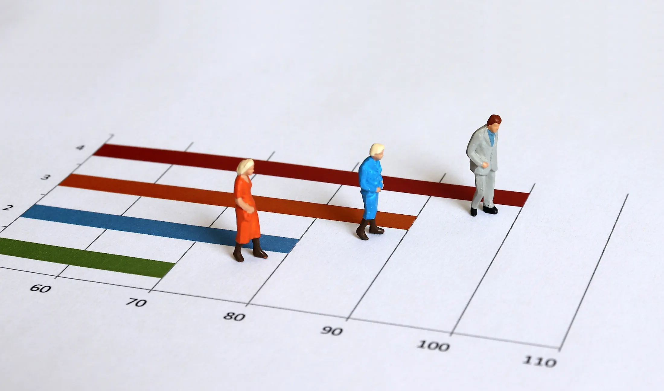



Research – Our Higher Calling
Do GDP, HDI, CPI or Population Density lead to higher incidence of COVID cases or deaths?
This Photo by Unknown Author is licensed under CC BY-NC
Notes:
E

Slide 3
Dataset = OWID + CPI
OWID data combines various datasets with real time reporting of COVID data (as of 4/30/21)
Corruption Perception Index in an independent factor that is reported annually
Notes:
E

Slide 4
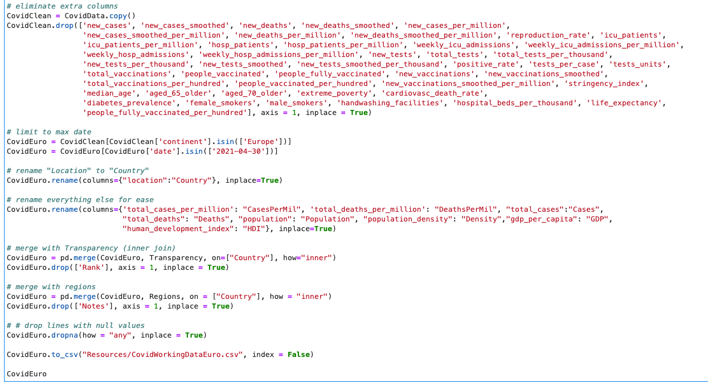
Data clean up
1) Pull in the csv file with 85580 records across 60 columns. Everything we tried to look at was general and murky.
2) Cut the down the data. We limited to the continent of Europe as of 4/30/2021 and were left with 48 records with 12 columns.
3) Renamed lots of fields because things like “total_deaths_per_million” were going to be horrible to query.
4) Merged via inner joins to add in corruption perception index and separate Europe into four regions.
6) Charts were throwing out errors, so we removed records with N/A values and were left with 40 records and 14 columns to work with.
Notes:
G

Slide 5
Data exploration
(The things that didn’t work)

Slide 6
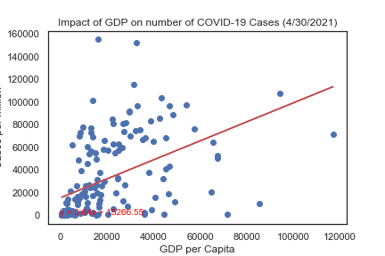
Regression – Global GDP
Notes:
E

Slide 7
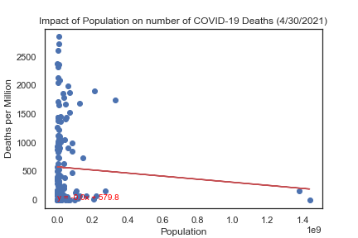
Regression – Global Population
Notes:
E

Slide 8
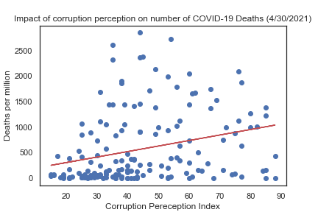
Regression – Global Transparency
Notes:
E

Slide 9
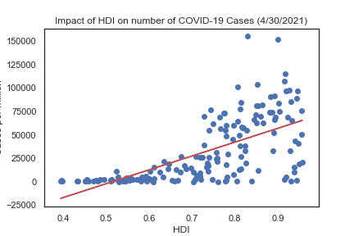
Regression – Global HDI (More Correlated)
Notes:
E

Slide 10
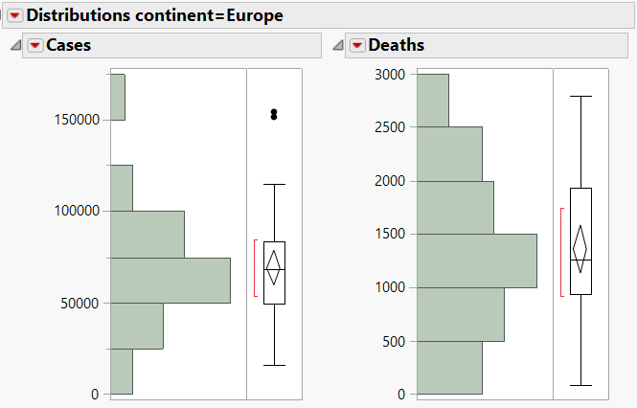

The Path Forward - Europe
Globally the relationships we looked at were weak and not enough to explain what might be going on
Europe had the most normal distribution of case and death data of the continents
This Photo by Unknown Author is licensed under CC BY-SA
Notes:
E

Slide 11

Statistical Analysis
Drilling down into Europe

Slide 12
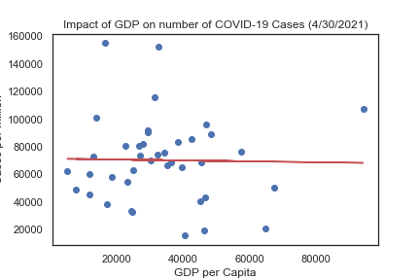
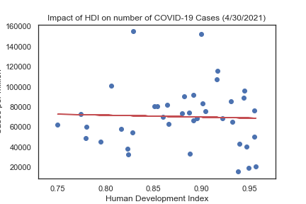
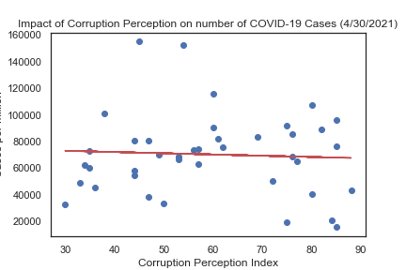
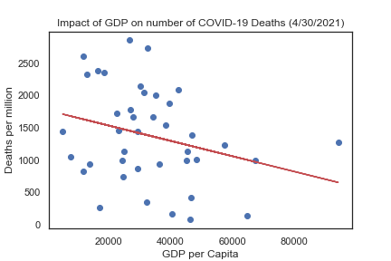
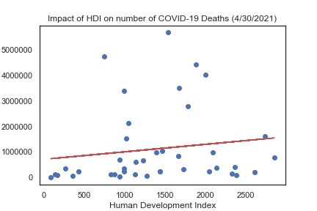
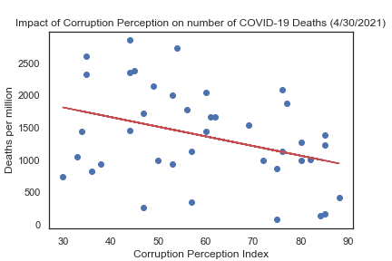
A LOT OF NOTHING
Creating scatter plots to see the relationship between GDP, Human Development Index (HDI) and Corruption perception showed ups that there was little to no correlation between any of these metrics and Cases or Deaths per million.
r² = 0.0
r² = 0.0
r² = 0.0
r² = 0.08
r² = 0.02
r² = 0.13
Notes:
M

Slide 13
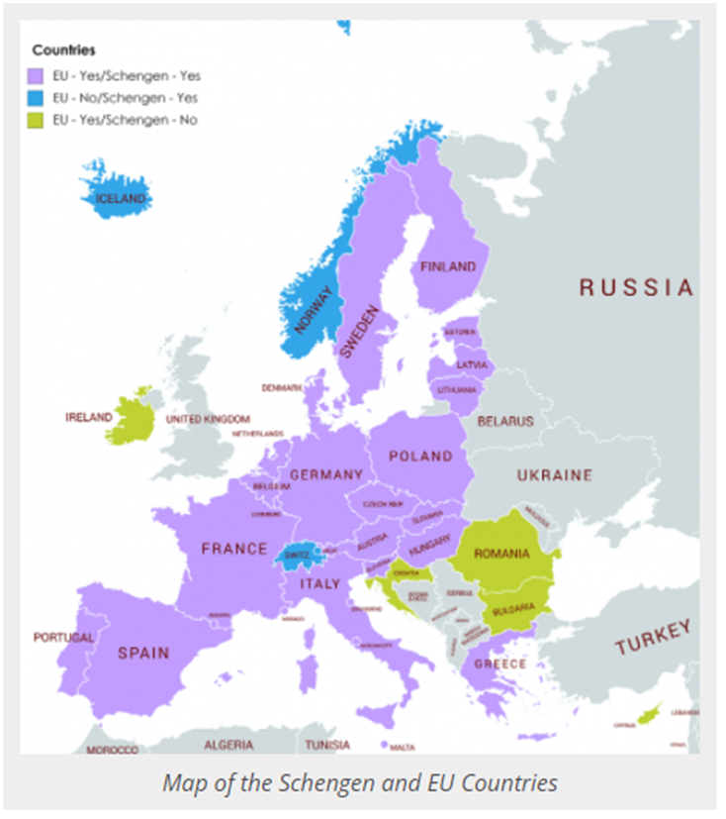
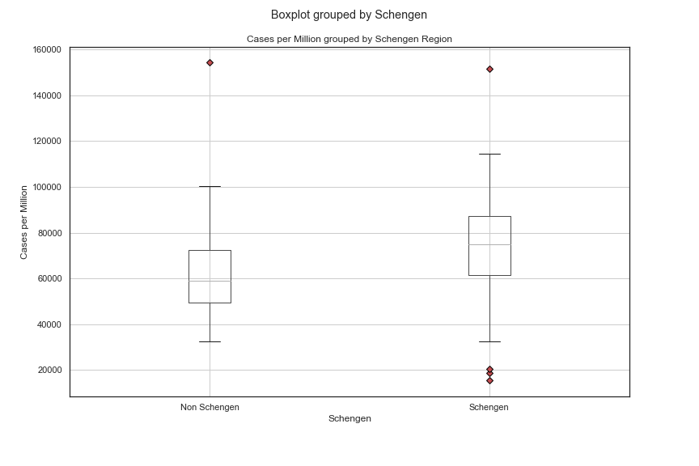
Schengen Region
We considered free movement as a factor, but…
P value = 0.516 (cannot reject the null hypothesis)
Notes:
M

Slide 14
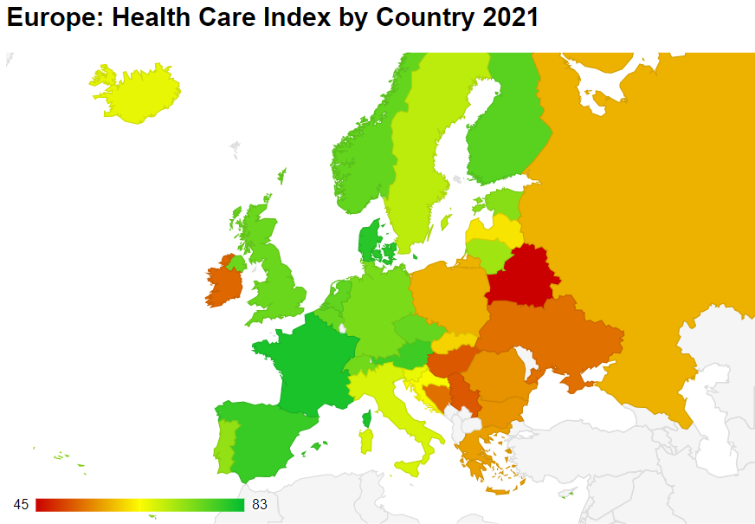
Standard of Living Index
We also considered factors such as access to health care, cost of living, and purchasing power, but….
All t-tests comparing countries above the median index with those below the median index had p-values of .10 or higher for both COVID cases and deaths
Notes:
M

Slide 15
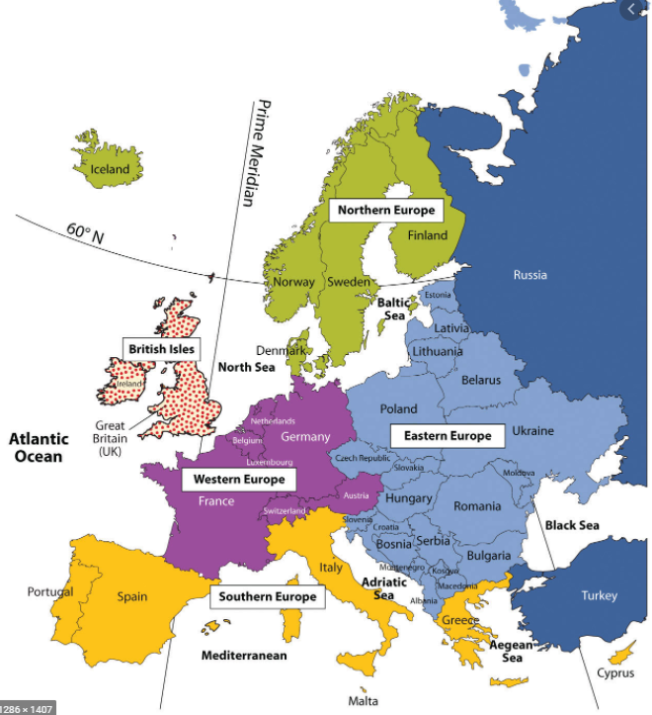
Euro-Regions Groups
We tried separating Europe into four regions.
Don’t Russian to judgment!
We included Russia in the European dataset, even though it is trans-continental, for three reasons:
About 75% of the Russian population lives in the European continent.
Russia accounts for nearly 40% of European landmass
That’s how the OWID data classified it
Notes:
M

Slide 16
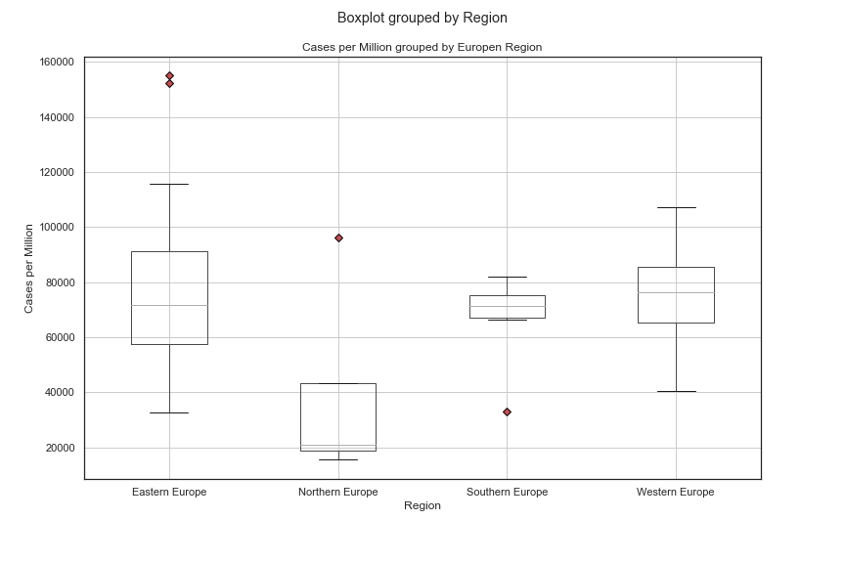
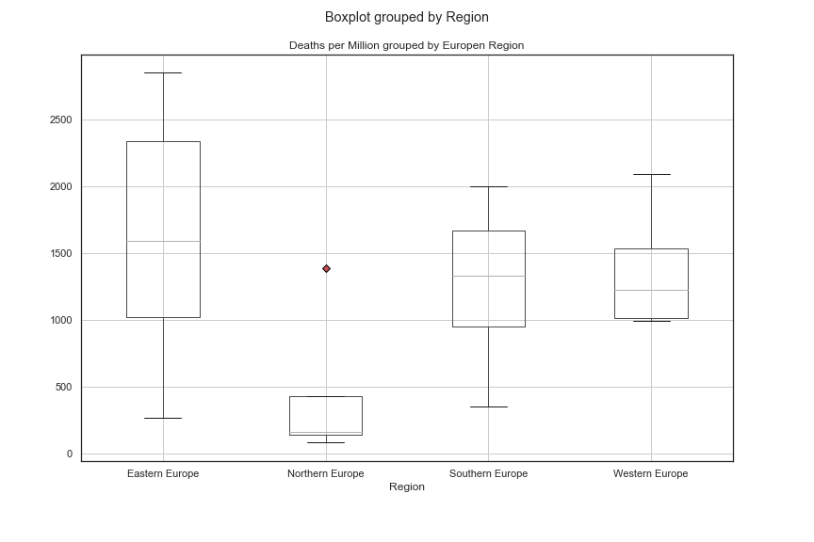




Stacking Up the Boxes
Czechia
Montenegro
Sweden
Sweden
Greece
By simply charting a boxplot of the different regions, we could see that Northern Europe looked different enough from the other three regions to be worth investigating.
Notes:
G

Slide 17
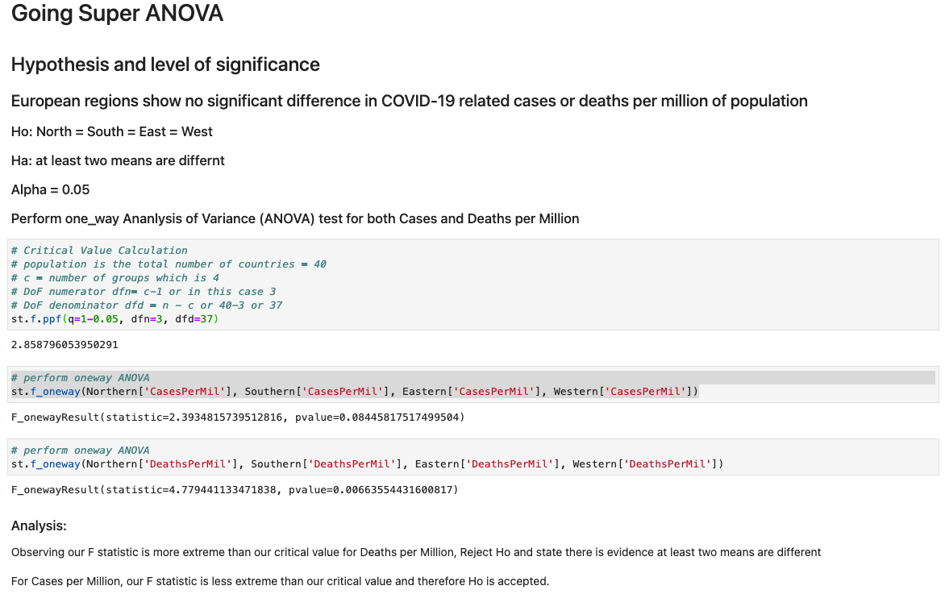
ANOVA Testing
For Cases per Million, H₀ was accepted with a p-value of 0.0845 against an Alpha of 0.05
For Deaths per Million H₀ was rejected with a p-value of 0.0066 against an Alpha of 0.05
If you remove Sweden from the data due to the failure* of their plan to use common sense rather than restrictions, p-values are 0.01236 and 0.00215 for Cases and Deaths, respectively.
* https://www.bbc.com/news/world-europe-55347021
Notes:
G

Slide 18
T-Tests by Region
Cases per Million
Region | Northern | Southern | Eastern
Southern | 0.17456
Eastern | 0.09409 | 0.45341
Western | 0.04081 | 0.63630 | 0.15506
The ANOVA test showed that there were differences in at least one region for Deaths per Million, but we were curious exactly which region or regions were different.
For Cases per Million, the only combination with p-value less than 0.05 was Northern Europe vs Western Europe.
For Deaths per Million, Northern Europe had p-values less than 0.05 for both Eastern and Western Europe.
Deaths per Million
Region | Northern | Southern | Eastern
Southern | 0.15572
Eastern | 0.02734 | 0.41709
Western | 0.04365 | 0.85791 | 0.20632
Notes:
G

Slide 19

Conclusions (are we Finnish yet?)
In terms of cases & deaths, countries are probably different from one another!
Intuitively, it makes sense that Northern Europe is different from other regions
We were surprised that Eastern Europe wasn’t different
In general, geopolitical measures such as GDP, total population, and HDI seemed to have low measurability on COVID case or death outcomes
Notes:
M

Slide 20

Suggestions for Future Research
Identify biases in reporting
Is the data accurate, complete, and consistent?
Are results skewed by the ability to afford testing?
Are governments underreporting to mask the issue?
Find datasets with more granularity
Too much data makes it hard to see the forest for the trees
Find additional metrics
Percent positivity
Tests per capita
Look at vaccines
With only four months of vaccinations and few countries with large scale programs it was difficult to form a solid conclusion
This Photo by Unknown Author is licensed under CC BY-NC
Notes:
M

Slide 21
Works Cited
Marsja, Erik. “Four Ways to Conduct One-Way ANOVA with Python.” Erik Marsja, 19 Nov. 2020,
“2020 - CPI.” Transparency.org, www.transparency.org/en/cpi/2020.
“Schengen Countries: Visa Information for Schengen Area.” ETIAS Visa Waiver for Europe, www.etiasvisa.com/schengen-visa/countries.
Regions of Western Europe, saylordotorg.github.io/text_world-regional-geography-people-places-and-globalization/s05-04-regions-of-western-europe.html.
Standard Of Living By Country 2021, worldpopulationreview.com/country-rankings/standard-of-living-by-country.
“Boxplot : Outliers Labels Python.” Edited by Andrea Blengino 4, Stack Overflow, 7 Nov. 2016, 16:41, stackoverflow.com/questions/40470175/boxplot-outliers-labels-python.
Mooney, Paul. “Latitude and Longitude for Every Country and State.” Kaggle, 13 Mar. 2020, www.kaggle.com/paultimothymooney/latitude-and-longitude-for-every-country-and-state.

